Slide 1
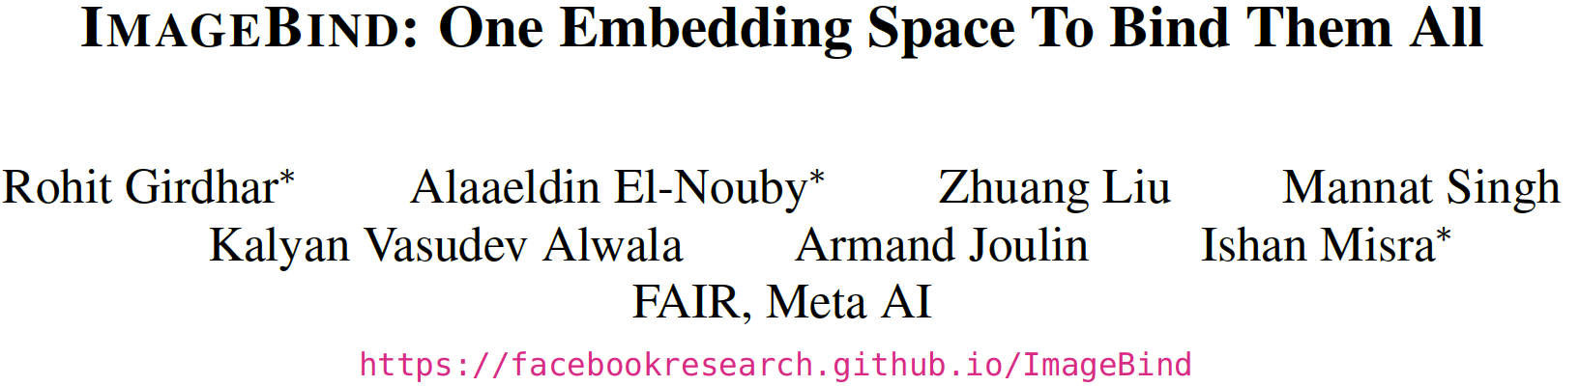
Presenter: Jingjing Li
2024.09.19

Slide 2
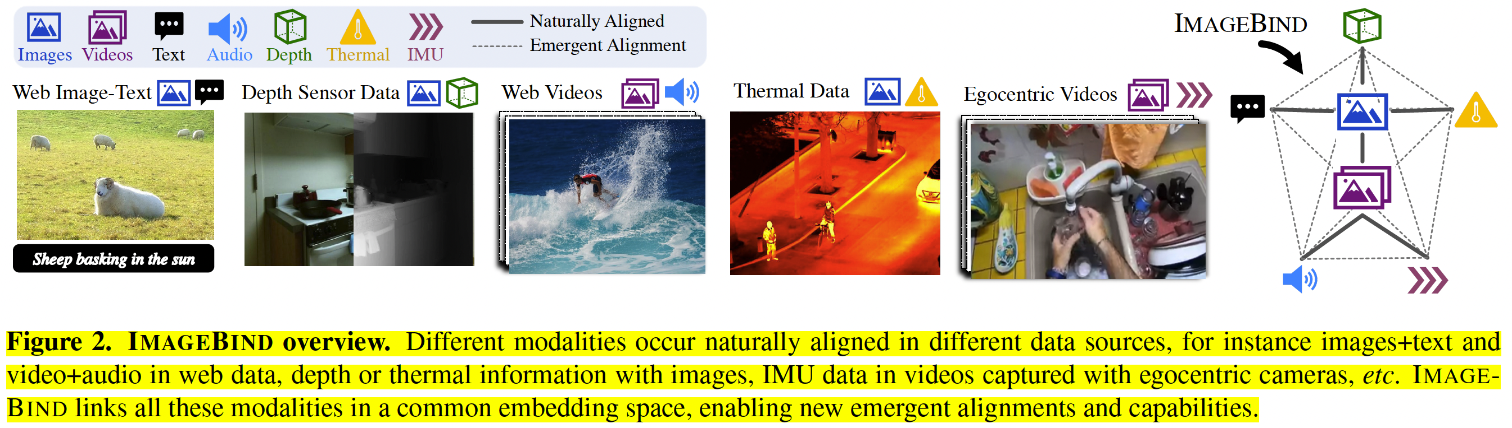
ImageBind
One embedding to bind them all
leverage the binding property of images and we show that just aligning each modality’s embedding to image embeddings leads to an emergent alignment across all of the modalities.

Slide 3
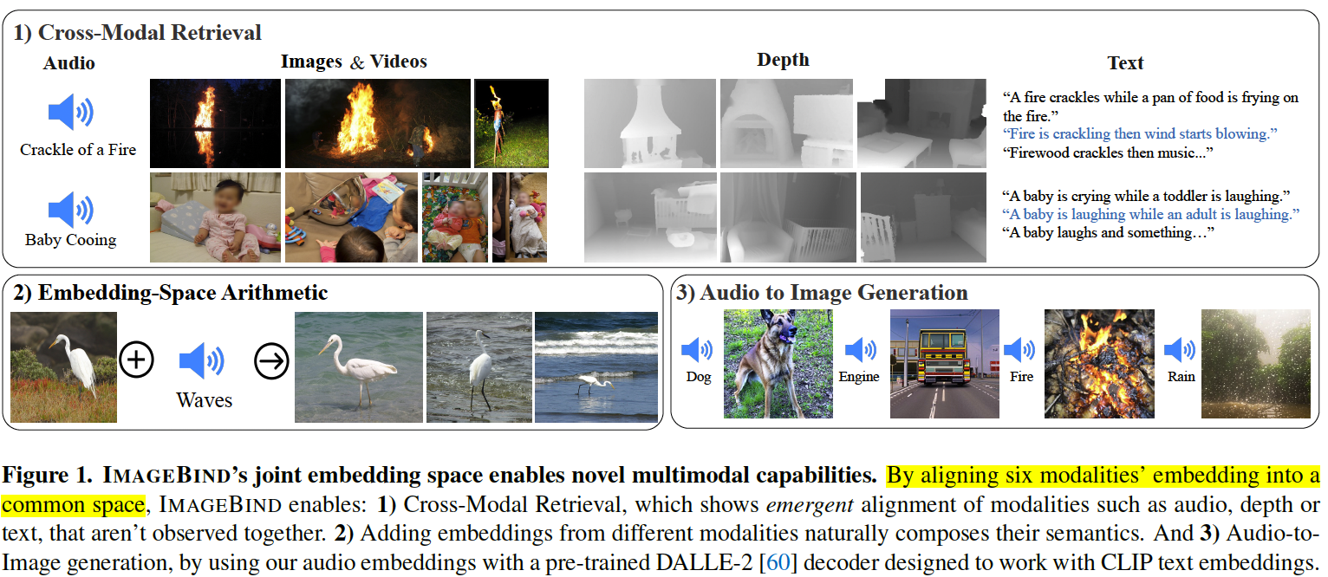
Emergent multimodal applications

Slide 4
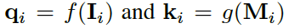
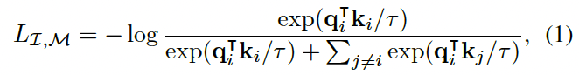
Method
Binding modalities with images
large-scale web datasets with (image, text) pairings
natural, self-supervised pairing of other modalities – audio, depth, thermal, and IMU data – with images
Emergent alignment of unseen pairs of modalities
We observe an emergent behavior in the embedding space that aligns two pairs of modalities (M1,M2) even though we only train using the pairs (I,M1) and (I,M2).
This behavior allows us to perform a wide variety of zero-shot and cross-modal retrieval tasks without training for them.

Slide 5
Method
Implementation details
We use separate encoders for images, text, audio, thermal images, depth images, and IMU.
We add a modality specific linear projection head on each encoder to obtain a fixed size d dimensional embedding, that is normalized and used in the InfoNCE loss
This setup allows us to also initialize a subset of the encoders using pretrained models, e.g., the image and text encoder using CLIP [59] or OpenCLIP [29].
The image and text encoders are kept frozen during the IMAGEBIND training and the audio, depth, thermal, and IMU encoders are updated.
Datasets
(image, text) pairs from large-scale web data from CLIP.
(video, audio) pairs from the Audioset dataset.
(image, depth) pairs from the SUN RGB-D dataset
(image, thermal) pairs from the LLVIP dataset
(video, IMU) pairs from the Ego4D dataset
For naturally paired modalities and datasets, we do not use any extra supervision like class labels, text etc.

Slide 6
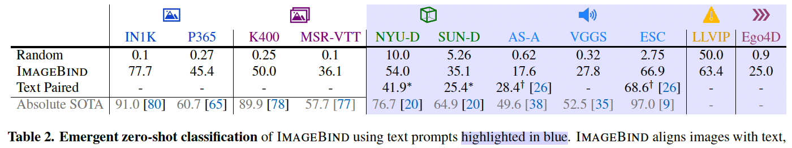
Experiments
Emergent zero-shot classification
measures IMAGEBIND’s ability to associate text embeddings to the other modalities without observing them together during training.
IMAGEBIND achieves a high emergent zero-shot classification performance.
even compares favorably to supervised specialist models trained for the specific modality and task.
These results demonstrate that IMAGEBIND aligns the modalities and implicitly transfers the text supervision associated with images to other modalities like audio.
In particular, IMAGEBIND shows strong alignment for non-visual modalities like audio and IMU suggesting that their naturally available pairing with images is a powerful source of supervision.

Slide 7
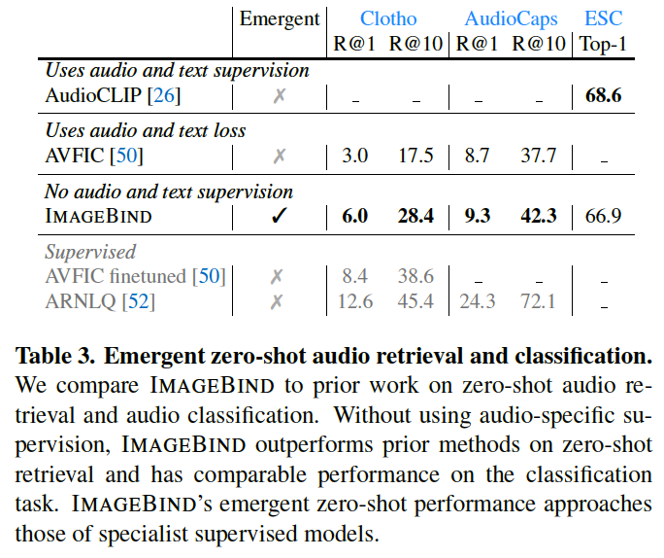
Experiments
Zero-shot text-to-audio retrieval and classification
Prior work trains using paired data for that modality e.g., AudioCLIP [26] uses (audio, text) supervision and AVFIC [51] uses automatically mined (audio, text) pairs.
On the Clotho dataset, IMAGEBIND has double the performance of AVFIC despite not using any text pairing for audio during training.
Compared to the supervised AudioCLIP model, IMAGEBIND achieves comparable audio classification performance on ESC.
Validates ImageBind’s ability to align the audio and text modalities using images as a bridge.

Slide 8
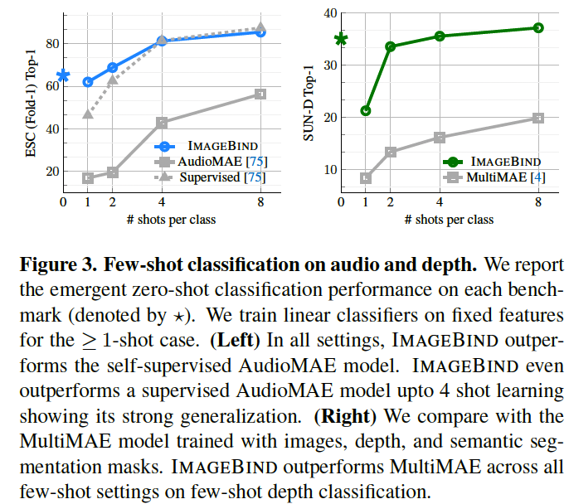
Experiments
Few-shot classification
These results show the strong generalization of IMAGEBIND audio and depth features trained with image alignment.

Slide 9
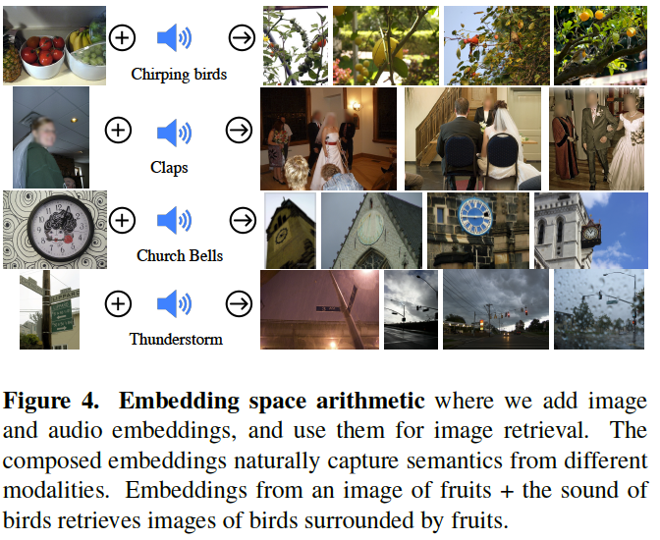
Analysis and Applications
Multimodal embedding space arithmetic
We study whether IMAGEBIND’s embeddings can be used to compose information across modalities.
The joint embedding space allows for us to compose two embeddings: e.g., image of fruits on a table + sound of chirping birds and retrieve an image that contains both these concepts, i.e., fruits on trees with birds.
This will likely enable a rich variety of compositional tasks.

Slide 10
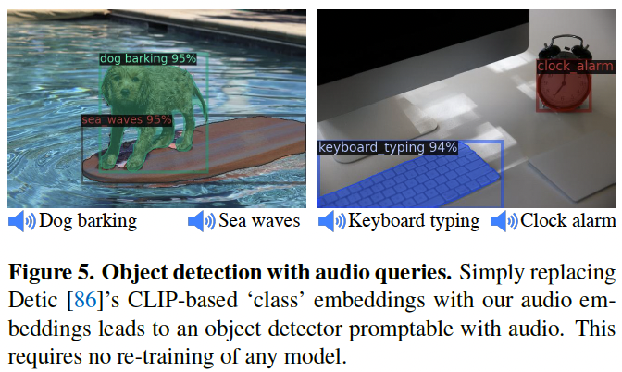
Analysis and Applications
Upgrading text-based detectors to audio-based.
A pretrained text-based detection model, Detic [86]
simply replace its CLIP-based ‘class’ (text) embeddings with IMAGEBIND’s audio embeddings.
Without training, this creates an ‘audio’-based detector that can detect and segment objects based on audio prompts.
E.g., we can prompt the detector with the barking sound of a dog to localize a dog.

Slide 11
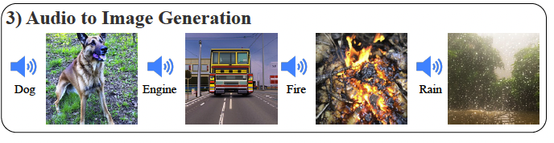
Analysis and Applications
Upgrading text-based diffusion models to audio-based.
We use a pretrained DALLE-2 [60] diffusion model (private reimplementation) and replace its prompt embeddings by our audio embeddings.
we observe that we can repurpose the diffusion model to generate images using different types of sounds.

Slide 12
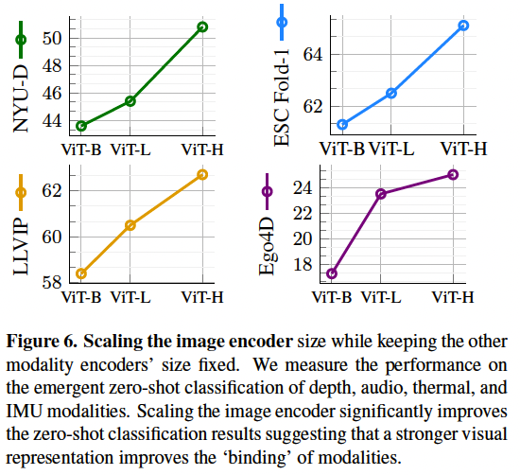
Ablation – Scaling the Image Encoder

Slide 13
Ablations
Contrastive loss temperature
Projection head
Training epochs
Data augmentation
Capacity of the audio and depth encoders
Batch size

Slide 14
Thanks!

